Slide 1
Research direction and timeline
Chad Weatherly
PhD Student, University of Houston
Advisor: Dr. Ricardo Vilalta

Slide 2
Background
NVIDIA uses Deep Learning Super-Sampling (DLSS), a software on their GPUs, to have
High framerates
High quality (4K)
Ray-tracing
DLSS renders low-resolution frames using game physics engine and then performs frame restoration using multiple deep learning models to upsample and perform anti-aliasing
Image Credit: https://developer.nvidia.com/rtx/dlss

Slide 3
Background (cont’d)
Much faster performance than traditional video game physics computations
AMD & Intel have competing software implementations for their own chips
Image Credit: https://developer.nvidia.com/rtx/dlss

Slide 4
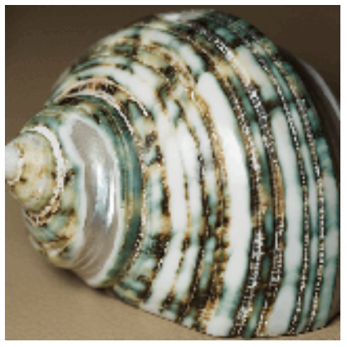
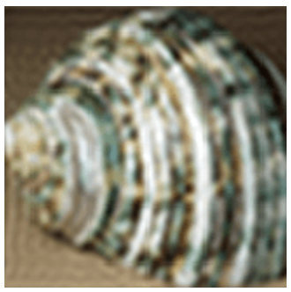
Problem Statement: SISR
𝟇
(Trivial)
Single Image Super-Resolution, (SISR) is the process of producing a high-resolution image/frame from a low-resolution one
A type of frame restoration
Assumes a degradation function, 𝟇
I_{LR} = 𝟇(I_{HR} ; 𝞱)
I_{LR} = Low-Resolution Image
I_{HR} = High-Resolution Image
𝞱 = Parameters for degradation factors, such as noise, motion blur, and downsampling
How can we find an approximation to 𝟇⁽⁻¹⁾ that will be perceptually appealing to a human observer?
𝟇⁽⁻¹⁾
(Non-trivial)
Image Credit: https://en.wikipedia.org/wiki/Image_scaling

Slide 5
Problem Statement: VSR
𝟇⁽⁻¹⁾
(Non-trivial)
Video Super-Resolution (VSR) is the process of producing a high-resolution video from a low-resolution one
Can use inter-frame/temporal information for better inference
A type of video restoration
How can we find an approximation to 𝟇⁽⁻¹⁾ that will be perceptually appealing to a human observer?
𝟇
(Trivial)
Image Credit: https://en.wikipedia.org/wiki/Image_scaling

Slide 6
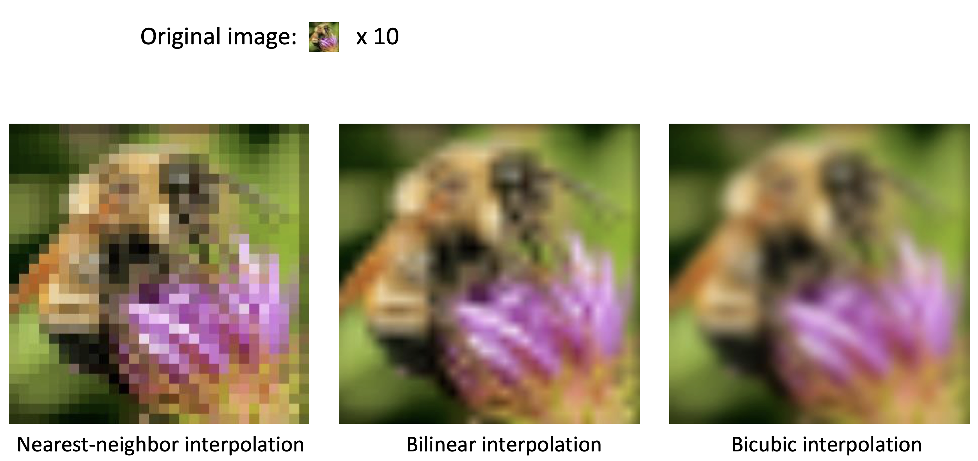
Prior Work
Frame Interpolation/Upsampling
Buggy
Grainy
Blurry
Image Credit: https://www.cs.toronto.edu/~guerzhoy/320/lec/upsampling.pdf

Slide 7
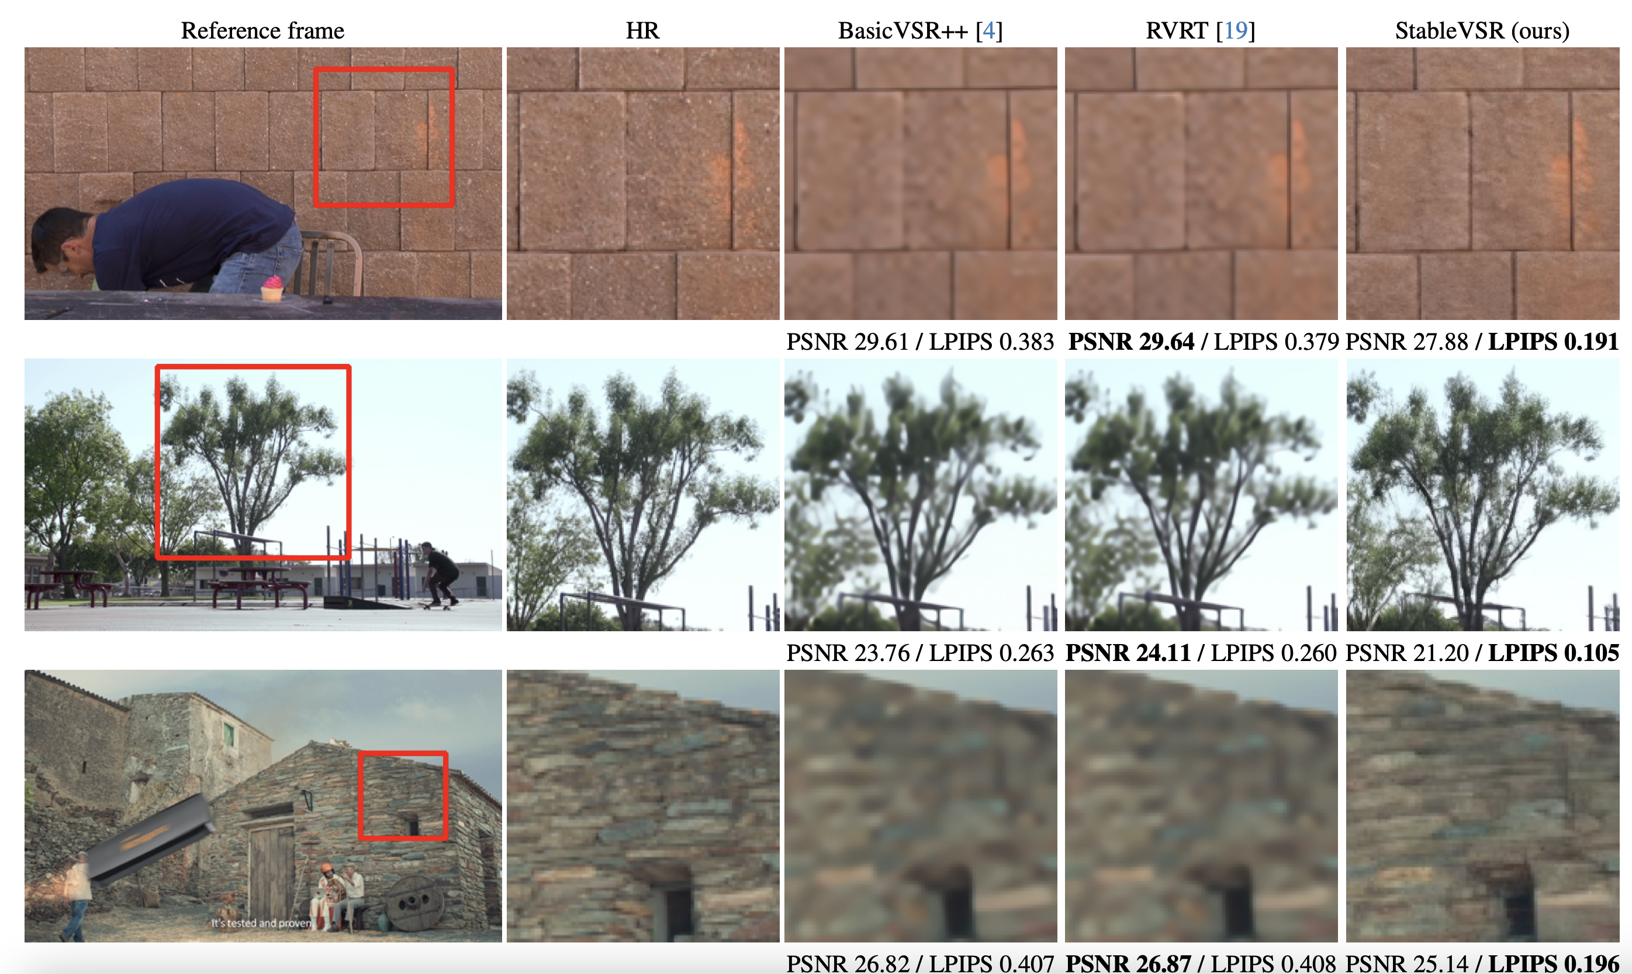
Prior Work (cont’d)
Deep Learning
Better results
More difficult / computationally heavy to train
Image Credit: https://arxiv.org/pdf/2311.15908.pdf

Slide 8
Prior Work (cont’d)
There are a few state-of-the-art architectures:
BasicVSR++, Recurrent Grid Network
RVRT, Recurrent Video Restoration Transformer
StableVSR, uses a Latent Diffusion Model for SISR w/ temporal conditioning module to perform VSR
Most SOTA methods are simple variations on previous model architectures and ill-posed, as training is done by minimizing either Peak Signal-to-Noise Ratio (PSNR) or Structural Similarity Matrix (SSIM)

Slide 9
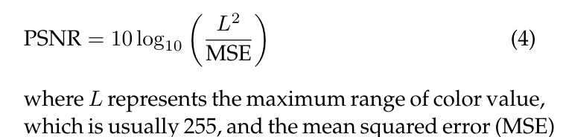
Prior Work (cont’d)
PSNR
Really, is a function of MSE
Lower is better
Model training is solely based on the perfect reconstruction of a LR frame
This tends to not create visually appealing results, even if the model converges well
Image Credit: https://ieeexplore.ieee.org/stamp/stamp.jsp?tp=&arnumber=10164823

Slide 10
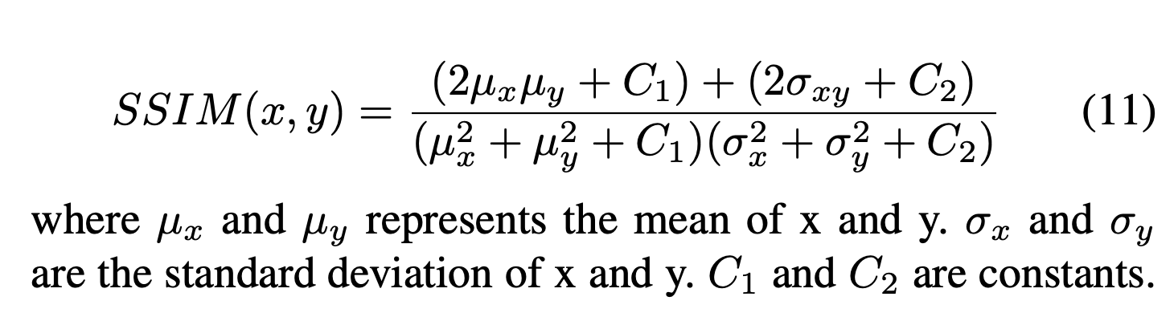
Prior Work (cont’d)
SSIM
Measures the difference in pixel color distribution between two frames
High similarity, SSIM → 1
Low similarity, SSIM → 0
Image Credit: https://ieeexplore.ieee.org/stamp/stamp.jsp?tp=&arnumber=10164823

Slide 11
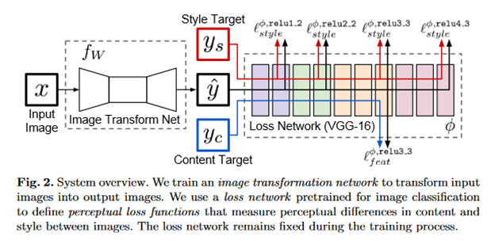
Prior Work (cont’d)
Both SSIM and PSNR do not necessarily create visually equivalent images
Is there a better metric to measure image similarity?
Perceptual Loss measures the difference in activation maps when two images are passed through a pre-trained vision model (usually VGG), because of its ability to extract features
Image Credit: https://ieeexplore.ieee.org/document/8578166/

Slide 12
Thank you!
Questions?

